Slide 1

Computer Networks
Week # 03
M.Nadeem Akhtar
CS & IT Department
The University of Lahore
Email: nadeem.akhtar@cs.uol.edu.pk
URL-https://sites.google.com/site/nadeemuolcsccn/home
Powerpoint Templates

Slide 2
ACKNOWLEDGMENTS
These lecture slides contain material from slides prepared by Behrouz Forouzan for his book Data Communication and Networking (4^{th/} 5th edition).

Slide 3
Week 3: Course Plan
Signals
Transmission impairments
Signal-to-noise ratio
Channel Capacity

Slide 4
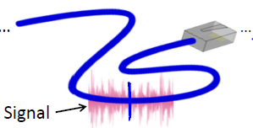
Physical Layer: Scope
What's carried across a physical channel, like a wire or a wireless or fiberoptic is an analog signal
We want to send digital bits
Need some way to represent digital bits with those analog signals
the heart of the Physical layer
For transmission, data needs to be changed to signals
10110
10110

Slide 5
Data and Signals
Data are entities that convey meaning
But Data communication at physical layer means exchanging signals
Data need to be transmitted and received, but the media have to change data to signals
A signal is an electric or electromagnetic encoding of data
OR Signal is detectable transmitted energy that can be used to carry information
Signaling is the act of propagating a signal along a medium
Major functions of the physical layer is to move data in the form of electromagnetic signals across a transmission medium

Slide 6
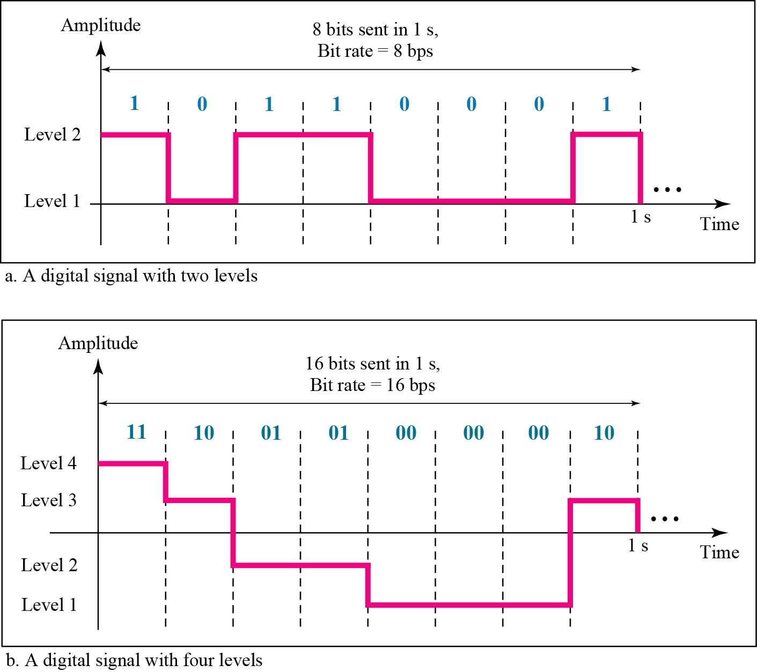
A digital signal can have more than two levels.
In this case, we can send more than 1 bit for each level
Digital signals can propagate analog and digital data

Slide 7
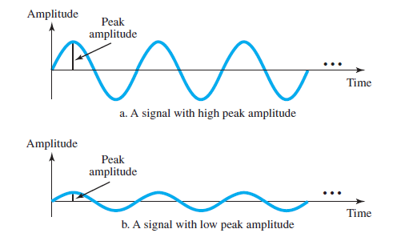
Parameters of a Sine Wave
Three parameters of a sine wave
Peak amplitude
Frequency / Period
phase
Peak amplitude of a signal is the absolute value of its highest intensity, proportional to the energy it carries
It is normally measured in volts for electrical signals

Slide 8
Amplitude (A)
Amplitude of a signal is the value of the signal at any point on the wave.
It is equal to the vertical distance from a given point on the wave form to the horizontal axis.

Slide 9

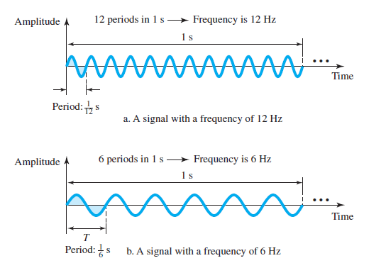
Parameters of a Sine Wave
Period and Frequency (one characteristic, defined in two ways)
Period refers to the amount of time, in seconds, a signal needs to complete 1 cycle.
Frequency refers to the number of periods in 1 s (expressed in Hertz (Hz)).
Frequency and period are the inverse of each other.

Slide 10
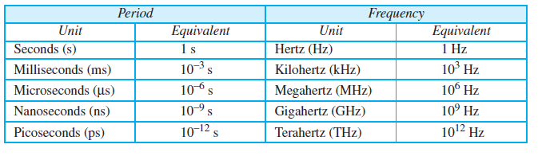
Parameters of a Sine Wave
Units of Period and Frequency
Express a period of 100 ms in microseconds?
The power we use at home has a frequency of 60 Hz. What is the Period of this sine wave?
The period of a signal is 100 ms. What is its frequency in kilohertz?

Slide 11
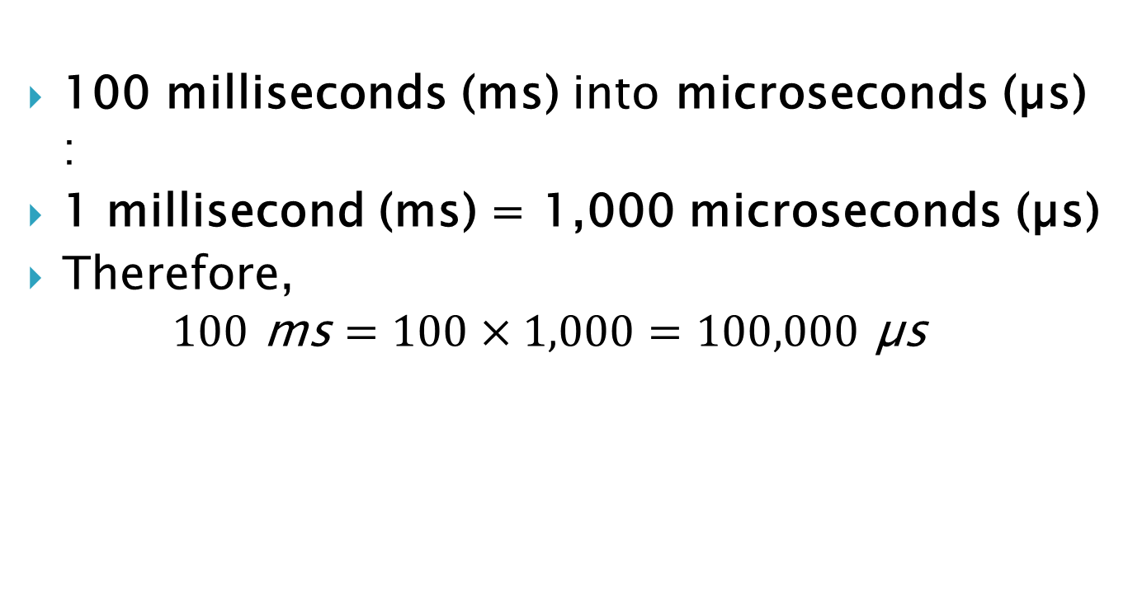
Express a period of 100 ms in microseconds?
100 milliseconds (ms) into microseconds (µs) :
1 millisecond (ms) = 1,000 microseconds (µs)
Therefore, $100 \text{ms}=100×1,000=100,000\text{ µ}\text{s}$

Slide 12
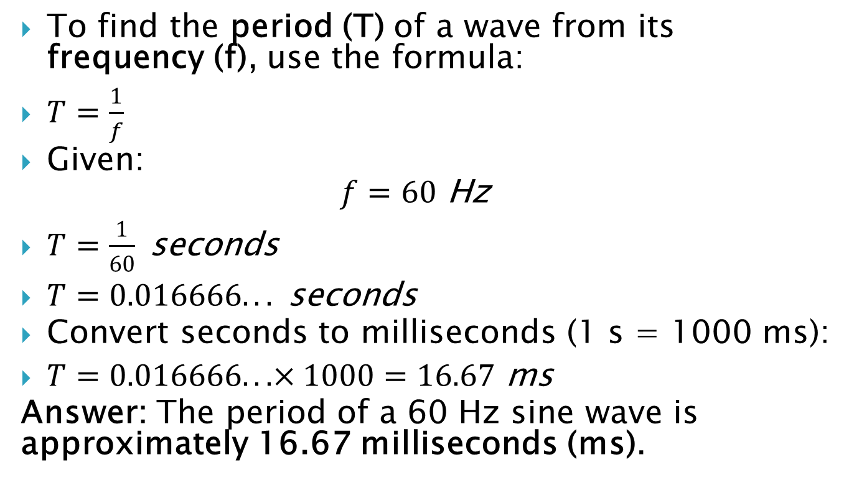
The power we use at home has a frequency of 60 Hz. What is the Period of this sine wave?
To find the period (T) of a wave from its frequency (f), use the formula:
$T=\frac{1}{f}$
Given: $f=60 \text{Hz}$
$T=\frac{1}{60} \text{seconds}$
$T=0.016666... \text{seconds}$
Convert seconds to milliseconds (1 s = 1000 ms):
$T=0.016666...×1000=16.67 \text{ms}$
Answer: The period of a 60 Hz sine wave is approximately 16.67 milliseconds (ms).

Slide 13
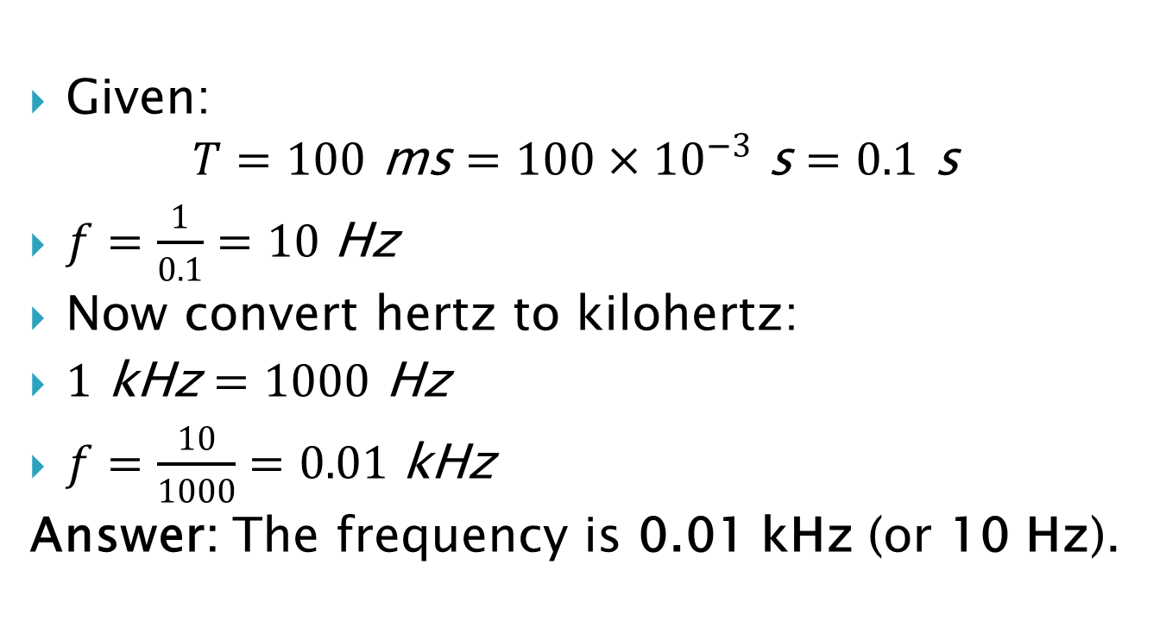
The period of a signal is 100 ms. What is its frequency in kilohertz?
Given: $T=100 \text{ms}=100×{10}^{−3} \text{s}=0.1 \text{s}$
$f=\frac{1}{0.1}=10 \text{Hz}$
Now convert hertz to kilohertz:
$1 \text{kHz}=1000 \text{Hz}$
$f=\frac{10}{1000}=0.01 \text{kHz}$
Answer: The frequency is 0.01 kHz (or 10 Hz).

Slide 14
Parameters of a Sine Wave
Frequency is rate of change with respect to time.
Change in a short span of time means high frequency.
Change over a long span of time means low frequency.
What if a signal does not change at all?
If a signal does not change at all, it never completes a cycle, so its frequency is 0 Hz.
What if a signal changes instantaneously? Or What if it jumps from one level to another in no time?
When a signal changes instantaneously, its period is zero; So frequency is 1/0, or infinite (unbounded).

Slide 15
Parameters of a Sine Wave
Phase or phase shift, describes the position of the waveform relative to time 0.
Think of the wave as something that can be shifted backward or forward along the time axis, phase describes the amount of that shift.
It indicates the status of the first cycle.
It is a constant that tells at what value the sine function has when t=0 and x=0
Phase is measured in degrees or radians
[360º is 2π rad; 1º is 2π/360 rad, and 1 rad is 360/(2π)].

Slide 16
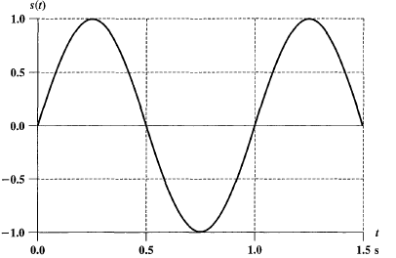
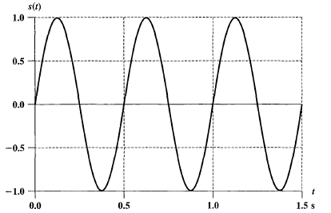
A = ?, f = ?, T = ?, φ = ?
A = 1 (in both), f = 1 and 2, T = 1 and 1/2, φ = 0 (in both)

Slide 17
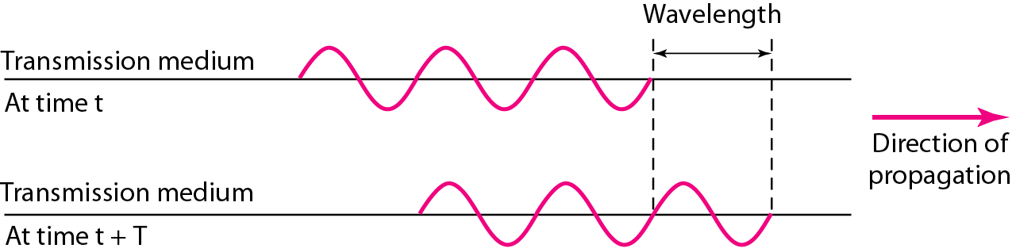
Wavelength (λ)
It is the distance a simple signal can travel in one period or
the distance between two points of corresponding phase of two consecutive cycles
It binds the period or frequency of simple sine wave to the propagation speed of the medium
It is often used to describe the transmission of light in an optical fiber (normally measured in micrometers (microns))

Slide 18
Wavelength (λ)
given the propagation speed (the speed of light) and the period of the signal, wavelength can be calculated
Relationship between wavelength and period
Wavelength = (propagation speed) X period = propagation speed /frequency
λ = v T or λ f = v (as T = 1/f)
in free space, v is equal to speed of light, so v = c
c is approx. 3 X 10⁸ m/s
The wavelength of red light (frequency = 4 × 10¹⁴) in air is
λ = c/ f = 3X 10⁸ / 4X 10¹⁴ = 0.75 X 10⁻⁶ m

Slide 19
Composite Signals
In data communication, single-frequency sine wave is not useful
we need to send a composite signal
A composite signal is a combination of simple sine waves with different frequencies, amplitudes, and phases (Fourier analysis)
It can be periodic or nonperiodic
The decomposition of a periodic signal gives a series of signals with discrete frequencies while
The decomposition of a nonperiodic signal gives a combination of sine waves with continuous frequencies

Slide 20
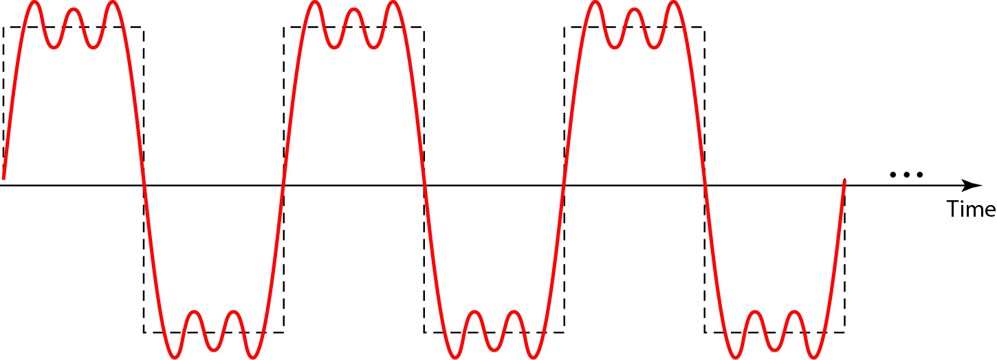
Example
Consider a periodic composite signal with frequency f. This type of signal is not typical of those found in data communications. We can consider it to be three alarm systems, each with a different frequency. The analysis of this signal can give us a good understanding of how to decompose signals.
A composite periodic signal

Slide 21
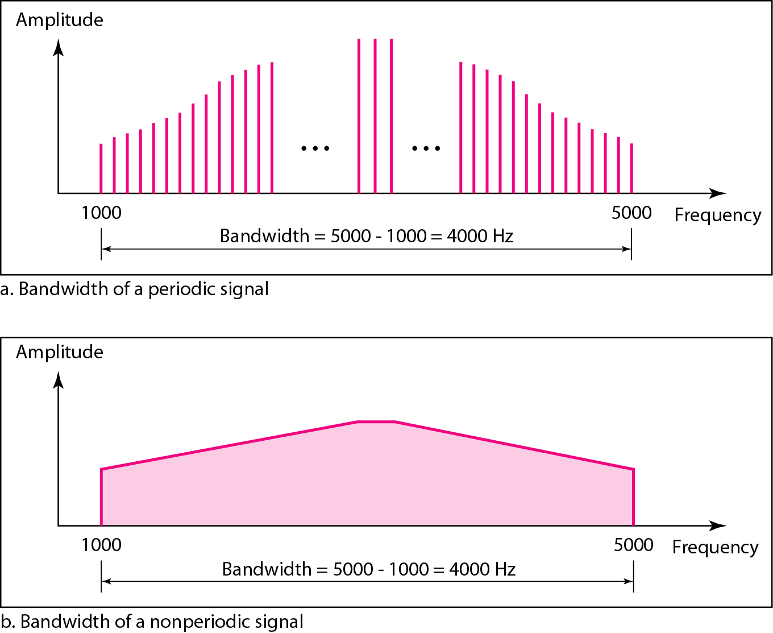
Bandwidth
The range of frequencies contained in a composite signal is its bandwidth.
The bandwidth is normally a difference between two numbers.

Slide 22
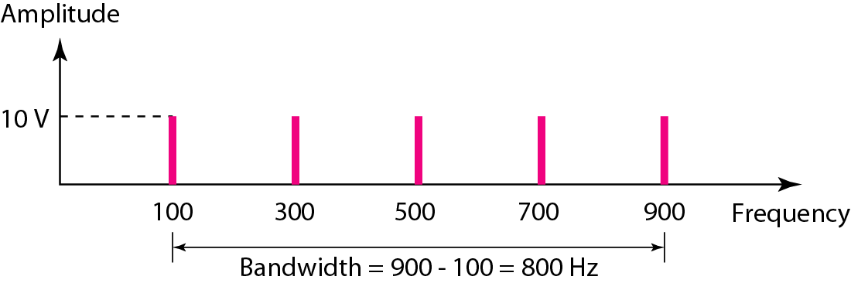
Example
If a periodic signal is decomposed into five sine waves with frequencies of 100, 300, 500, 700, and 900 Hz, what is its bandwidth? Draw the spectrum, assuming all components have a maximum amplitude of 10 V.
Solution
Let f_{h} be the highest frequency, f_{l} the lowest frequency, and B the bandwidth. Then
The spectrum has only five spikes, at 100, 300, 500, 700, and 900 Hz.

Slide 23
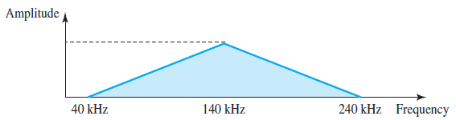
Example
A nonperiodic composite signal has a bandwidth of 200 kHz, with a middle frequency of 140 kHz and peak amplitude of 20 V. The two extreme frequencies have an amplitude of 0. Draw the frequency domain of the signal.

Slide 24
In digital signals
if a signal has L levels, each level needs log₂ L bits.
A digital signal has eight levels. How many bits are needed per level?
Number of bits per level = log₂ 8 = 3 bits
A digital signal has nine levels. How many bits are needed per level?
Number of bits per level = log₂9= 3.17 bits
Not realistic, so we need 4 bits

Slide 25
Concepts used to describe digital signals
Bit Rate (instead of frequency): is the number of bits sent in 1 second
Example: What is the bit rate of the channel if we need to download text documents at the rate of 100 pages per second?
100 pages X 24 line/page X 80 Char/line X 8 bits /Char = 1.536 Mbps
Q: What is the bit rate for high-definition TV (HDTV) that uses digital signals to broadcast high quality video signals?
Ans: There are 1920 by 1080 pixels per screen and the screen is renewed 30 times per second. Twenty-four bits represents one color pixel. So bit rate is
1920 X 1080 X 30 X 24 = 1,492,992,000 ≈ 1.5 Gbps

Slide 26
Concepts used to describe digital signals
Bit Length (similar to wavelength): distance one bit occupies on the transmission medium and is calculated by multiplying the propagation speed with bit duration
Bit length = propagation speed X bit duration
Bit duration is the time one bit occupies on the medium

Slide 27
TRANSMISSION IMPAIRMENTS
Signals travel through transmission media, which are not perfect
The imperfection causes signal impairment
The signal at the beginning of the medium is not the same as the signal at the end of the medium
What is sent is not what is received
For analog signals, these impairments introduce various random modifications that degrade the signal quality
For digital signals, bit errors may be introduced
Three causes of impairment are:
Attenuation
Distortion
Noise

Slide 28
Attenuation
Means loss of energy -> weaker signal
Signal strength of signal falls of with distance
When a signal travels through a medium it loses some of its energy so that it can overcome the resistance of the medium
Thus, a wire carrying electrical signals gets worm, if not hot, after a while
Some of the electrical energy in signal is converted to heat
To compensate for this loss of energy, Amplifiers are used to amplify the signal
Attenuation increases with frequency

Slide 29
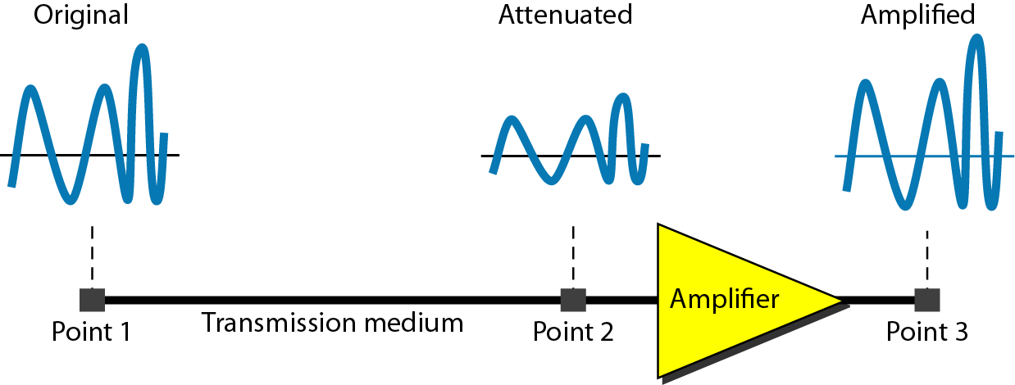
Measurement of Attenuation
To show the loss or gain of energy the unit “decibel (dB)” is used (as a constant number per unit distance for guided media)
For wireless transmission, it is more complex
Function of distance and makeup of the atmosphere

Slide 30

Attenuation: Example
Attenuation = 10log₁₀ p₂/p₁ (powers at point 1 & 2)
Suppose a signal travels through a transmission medium and its power is reduced to one-half. This means that P₂ is (1/2)P₁
In this case, the attenuation (loss of power) can be calculated as;
A loss of 3 dB (–3 dB) is equivalent to losing one-half the power

Slide 31
Distortion
The signal changes its form or shape
Distortion occurs in a composite signal made of different frequencies
Each frequency component has its own propagation speed traveling through a medium
The different components therefore arrive with different delays at the receiver (delay distortion)
That means that the signals have different phases at the receiver than they had at the source due to difference in delay
The shape of the composite signal is not the same

Slide 32
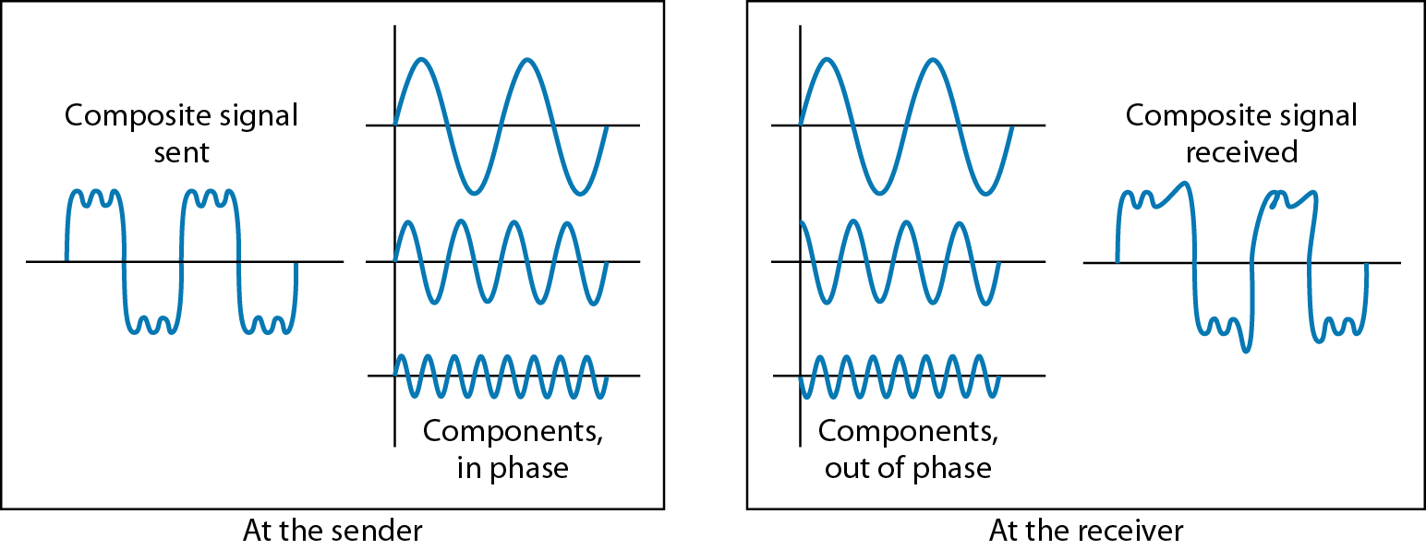
Distortion
The distortion is caused by the fact that the velocity of propagation of a signal through a medium varies with frequency
Velocity tends to be highest near the center frequency and to fall off toward the two edges of the band

Slide 33
Noise
Noise is any unwanted signal (inserted somewhere between transmission) that degrades signal quality
It combines with and distorts
the signal intended for transmission and reception
Noise is the major limiting factor in communications system performance
There are different types of noise like thermal, induced, crosstalk and impulse noise

Slide 34
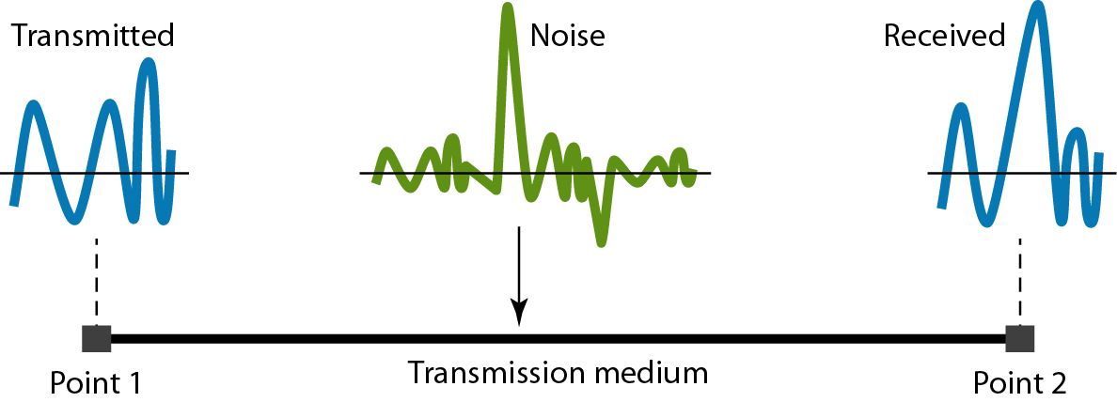
Noise

Slide 35
Channel capacity
The maximum rate at which data can be transmitted over a given communication path, or channel, under given conditions

Slide 36
Relationship between Data rate and Bandwidth
Spectrum
range of frequencies that a signal contains
Bandwidth
the difference between the minimum and maximum frequencies that a channel can handle (measured in Hz)
It dictates the information carrying capacity of the channel (in bps) which is calculated using
Data Rate or Bit Rate
how much "information" the system can handle at a given time, or information carrying capacity of a signal (Measured in bps)
Direct relationship between data rate and bandwidth
The greater the bandwidth, the higher the information-carrying capacity

Slide 37
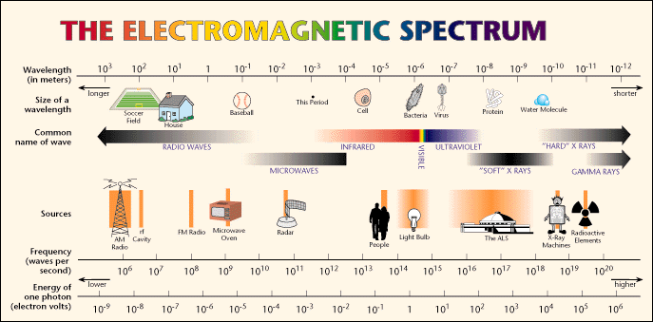

Slide 38
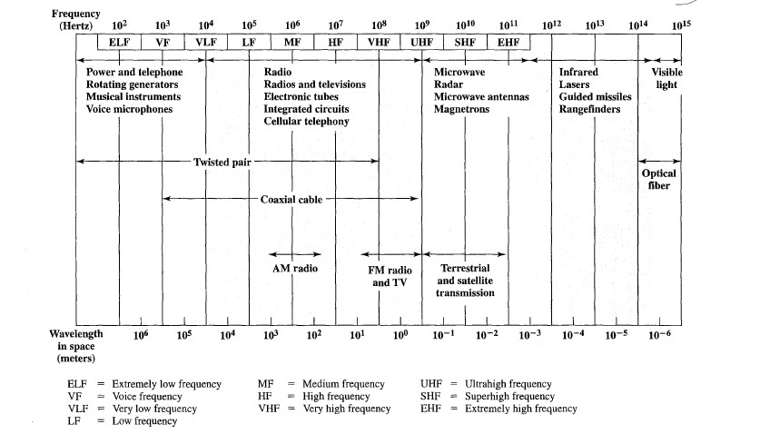
Spectrum for Telecommunication

Slide 39
Channel
A channel is portion of a transmission path dedicated to a pair of transmitter/receivers
usually characterized by its bandwidth
It is a physical transmission medium such as a wire, or
a logical connection over a multiplexed medium such as a radio channel
A channel or transmission medium may be simplex, half-duplex and full-duplex
A channel is used to convey an information signal, from one or several senders to one or several receivers

Slide 40
Communication facilities are expensive
Greater the bandwidth of a facility, the greater the cost
All transmission channels are of limited bandwidth
Make as efficient use as possible of a given bandwidth
At a particular limit of error rate (rate at which errors occur ) for a given bandwidth, get as high a data rate as possible
Error is reception of a 1 when a 0 was transmitted or reception of a 0 when a 1 was transmitted

Slide 41
Effects of Noise on Channel Capacity
Noise is the main constraint in achieving efficient use of bandwidth
It degrades the signal quality and thus limits the data rate that can be achieved
Noise is the average level of noise over the communications path
We use Signal-to-Noise-Ratio (SNR) to measure the quality of a system
Ratio of the signal power (S) to the noise power (N) that’s present at a particular point in the transmission

Slide 42
Signal-to-Noise Ratio (SNR)
It is the measure of signal strength relative to background noise, and typically measured at a receiver
SNR = signal power/noise power = S/N
It is usually given in dB (to show loss or gain in signal strength) and referred to as SNR_{dB}
The decibel (dB) is a logarithmic unit used to express the ratio between two values of a physical quantity
dB is negative if a signal is attenuated and positive if a signal is amplified

Slide 43
Signal-to-Noise Ratio
Example
The power of a signal is 10 mW and the power of the noise is 1 µW; what are the values of SNR and SNR_{dB}?

Slide 44
Signal-to-Noise Ratio
The values of SNR and SNR_{dB} for a noiseless channel are?
We can never achieve this ratio in real life; it is an ideal

Slide 45
Channel Capacity
Theoretical formulas to calculate the data rate
Nyquist bit rate (noiseless channel)
Shannon’s channel capacity formula (noisy channel)
1-Nyquist theorem:
Given a bandwidth of B, the highest signal rate that can be carried is 2B bps (binary signals or two voltage levels)
It assumes that channel is free of noise

Slide 46
Channel Capacity: Nyquist Bandwidth
Nyquist theorem:
In the general case, in which a signal element may represent more than one bit, we have:
maximum data rate = 2B log₂ V bits/sec
where V is the number of discrete signal or voltage levels
Increasing the levels of a signal may reduce the reliability of the system
No. of bits per level = log₂ V

Slide 47
Channel Capacity: Nyquist Bandwidth
Examples:
Bandwidth of voice grade line: 3000 Hz
using binary encoding (each signal level represents 1 bit)
maximum data rate = 2 X B = 2 X 3000 bits/sec
= 6000 bits/sec
If we have 16 distinct signals, each representing 4 bits (using QAM encoding)
maximum data rate = 2 X 3000 log₂ 16 bits/sec
= 24000 bits/sec

Slide 48
Nyquist Bandwidth: Examples
For a noiseless channel, bandwidth of 3100 Hz transmitting a signal with two signal levels
The maximum bit rate?

Slide 49
Nyquist Bandwidth: Examples
For a noiseless channel, bandwidth of 3100 Hz transmitting a signal with two signal levels
The maximum bit rate?
BitRate = 2 X 3100 X log₂ 2 = 6200 bps

Slide 50
Nyquist Bandwidth: Examples
For the same channel transmitting a signal with four signal levels (for each level, we send 2 bits). The maximum bit rate?

Slide 51
Nyquist Bandwidth: Examples
For the same channel transmitting a signal with four signal levels (for each level, we send 2 bits). The maximum bit rate?
BitRate = 2 X 3100 X log₂ (4) = 12400 bps

Slide 52
Nyquist Bandwidth: Examples
How many signal levels to send 200 kbps over a noiseless channel with a bandwidth of 20 kHz?
The maximum bit rate?
By using Nyquist formula
200000 = 2 X 20000 X log₂ V
log₂ V = 5
V = 2⁵ = 32 levels
Bit rate if V = 64, 128?
How many signaling levels are required when C = 8 Mbps and B = 1 MHz ?

Slide 53
2-Shannon capacity formula
maximum data rate or capacity of a noisy channel whose bandwidth is B Hz and whose signal-to-noise ratio is S/N, is given
This equation represents theoretical maximum that can be achieved
maximum data rate = B log₂(1+S/N) bps
Consider an extremely noisy channel
Where noise is so strong that the signal is faint; or
in which the value of the signal-to-noise ratio is almost zero
Capacity of this channel is
C = B log₂ (1 + SNR) = B 10g₂ (1 + 0) =B log₂ 1 = B x 0 = 0

Slide 54
2-Channel Capacity: Shannon’s Theorem
Shannon’s Theorem
Example: channel of 3000 Hz and SNR of 30 dB
C= B log₂(1+SNR) bps

Slide 55
2-Channel Capacity: Shannon’s Theorem
Shannon’s Theorem
Example: channel of 3000 Hz and SNR of 30 dB
C= B log₂(1+SNR) bps
First, obtain SNR (ratio) from SNR_{dB}
S/N = 10³ = 1000, and log₂ (1+S/N) is ≈ 2¹⁰
maximum data rate (C) = 3000 log₂(1+S/N) bps
≈ 3000 X 10 bps = 30000 bps

Slide 56
Shannon Formula: Example
Spectrum of a channel between 3 MHz and 4 MHz ; SNR_{dB} = 24 dB

Slide 57
Shannon Formula: Example
Spectrum of a channel between 3 MHz and 4 MHz ; SNR_{dB} = 24 dB
SNR= 10^{2.4}=251
Using Shannon’s formula

Slide 58
Shannon Formula: Example
Assume that SNR_{dB} = 36 and the channel bandwidth is 2 MHz
The theoretical channel capacity?

Slide 59
Shannon Formula: Example
Assume that SNR_{dB} = 36 and the channel bandwidth is 2 MHz
The theoretical channel capacity?

